Slide 1



Reflecting Energy Efficient Lighting and Appliances (EELA) in NDCs
EELA Project and its’ contribution to NDCs
Denis Ariho, Lead Technical Expert for EAC, EELA Project, EACREEE
05 July 2023

Slide 2
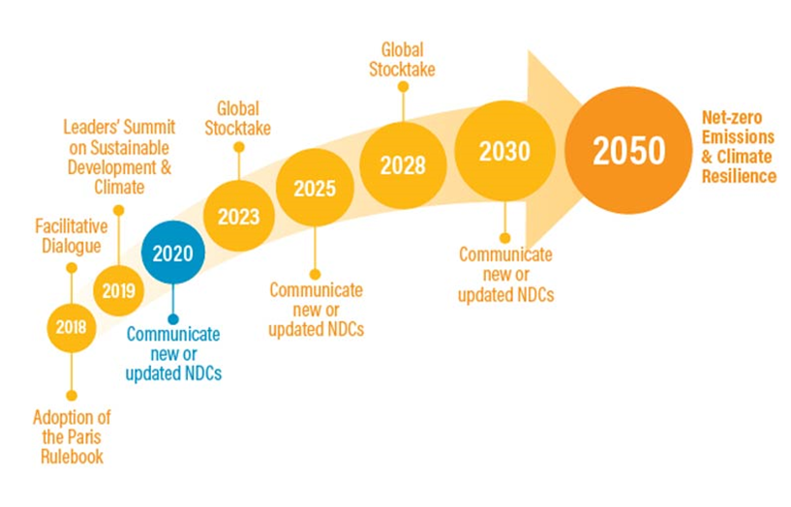
National Determined Contributions (NDCs)
Nationally Determined Contributions (NDCs), are countries' self-defined national climate pledges under the Paris Agreement, that indicate the countries plans to help meet the global goal to pursue 1.5°C, adapt to climate impacts and ensure sufficient finance to support these efforts.
They are short-term plans with ambitious targets, updated every five years.
The world is facing the challenges of climate change mainly caused by human activities. The challenges include: Drought, floods, increased air temperatures, etc.

Slide 3
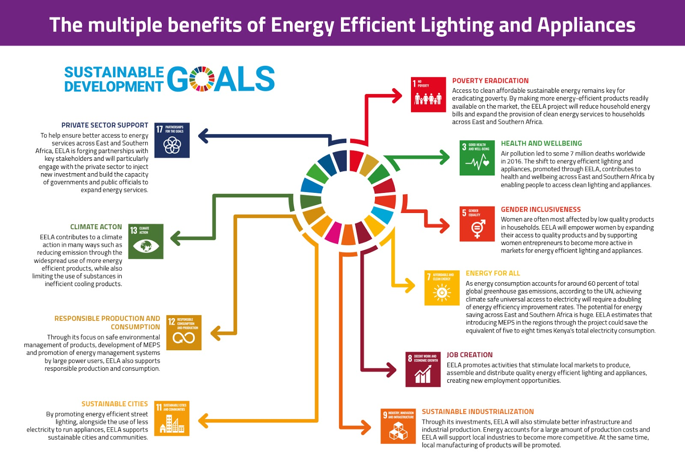
Energy Efficiency in NDCs
Energy efficiency is very relevant to achieve the global climate goals.
Majority of stakeholders in the EAC and SADC have limited understanding on energy efficiency.
Some countries in the EAC and SADC region have included energy efficiency targets in the NDCs. However, the targets are not robust enough to guide implementation.
In addition, very few countries have included energy efficient lighting and appliances in their updated NDCs.

Slide 4
Reflecting EELA in NDCs
Uganda
Energy efficiency targets: YES
Industrial energy efficiency, lighting energy efficiency, improved efficiency in charcoal production, etc
EELA
Lighting energy efficiency in households: CFLs, LEDs, replace lighting fuels (kerosene) with cleaner ones.
Kenya
Energy efficiency targets: YES
Clean, efficient and sustainable energy technologies to reduce over-reliance on fossil and non-sustainable biomass fuels.
Low carbon and efficient transport systems.
EELA
No

Slide 5
Reflecting EELA in NDCs
Rwanda
Energy efficiency targets: YES
Energy efficiency in agro-processing
Efficient brick kilns
Energy efficient cement production
Efficient lighting in buildings
Efficient cook stoves
Electric vehicles (EVs)
EELA targets
Yes.
Efficient lighting in buildings: 1.6 million CFL replacements with 7-year lifetime and 2 USD unit cost).
Tanzania
Energy efficiency targets: YES
Promoting climate resilient energy systems.
Reducing the consumption of charcoal in urban and rural areas
Promoting low emission transport systems through deployment of mass rapid transport system and investments in rail, maritime and road infrastructures, including high quality transport system and expansion/scaling up of BRT infrastructures.
EELA targets
No

Slide 6
Reflecting EELA in NDCs
South Africa
Energy efficiency targets: YES
National energy efficiency strategy
Company-level carbon budgets were introduced for large emitters on a voluntary basis in a first phase.
South Africa will invest in energy efficiency, a range of green transport measures including electric and hybrid vehicles, mode shifting and the enhanced provision of safe and affordable public transport.
EELA targets
No
Malawi
Energy efficiency targets: YES
There are general statements on energy efficiency.
EELA targets
No

Slide 7
Reflecting EELA in NDCs
Maritius
Energy efficiency targets: YES
Increase of energy efficiency by 10%.EELA targets
EELA targets
No
Namibia
Energy efficiency targets: YES
Generalised information
EELA targets
No

Slide 8
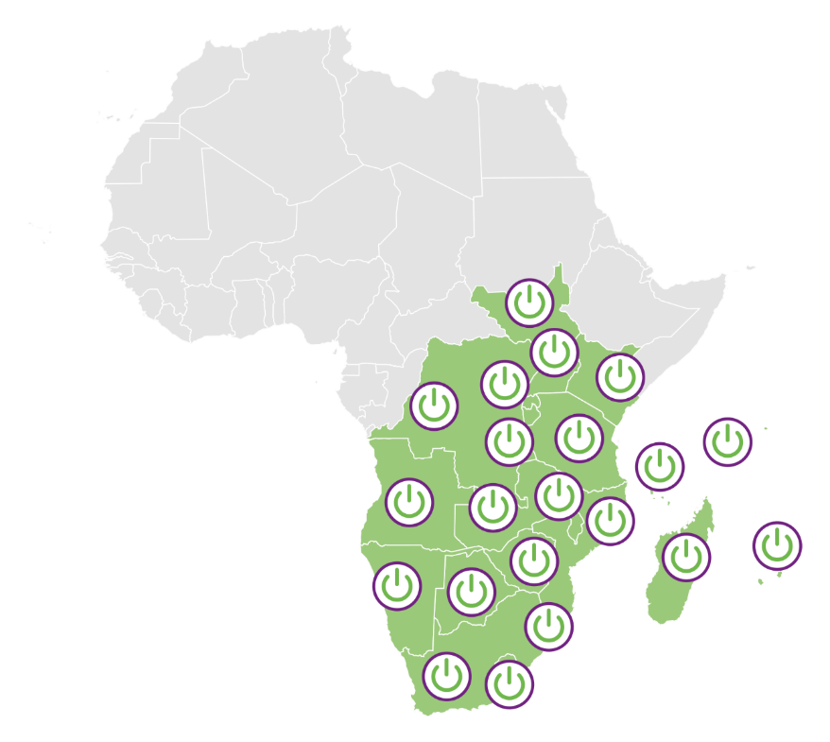







Energy Efficient Lighting and Appliances in East and Southern Africa - EELA
EELA has a transformational approach towards the development of vibrant markets where suppliers are delivering high-quality services and products for energy efficient lighting and appliances to increase awareness for households, businesses and public facilities across East and Southern Africa. EELA stimulates local manufacturing and private sector investments.
The EELA approach to change
Market incentives for the private sector to deliver efficient and high quality energy services
Minimum Energy Performance Standards (MEPS) for appliances which are harmonized in the region
A coordinated regional effort through RECS and regional sustainable energy centres
Capacity building on policy and regulatory framework development, appliances testing and regulatory enforcement
Implemented by UNIDO with financial support from the government of Sweden
Awareness raising on the benefits of adopting efficient technologies across all stakeholders

Slide 9
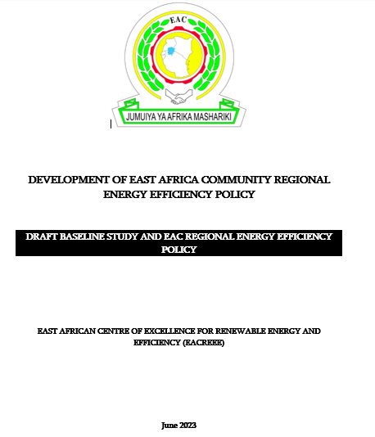
Regional Policy Harmonisation
EAC Regional Energy Efficiency Policy
EELA Project supporting the development of the EAC Regional Energy Efficiency Policy.
This EAC-EE Policy seeks to improve energy efficiency in the EAC Partner States and hence, accelerate access to modern energy services in the region.

Slide 10
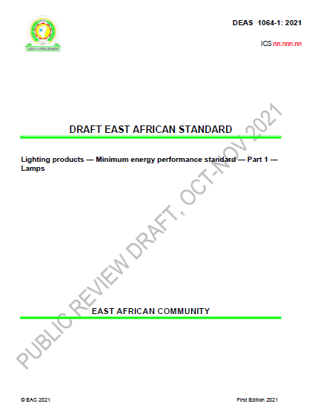
Regional Harmonised Minimum Energy Performance Standards
MEPS for lighting in EAC
The East African Standards Committee adopted the MEPS for lighting on 1st July 2022 and gave them reference numbers: EAS 1064-1&2:2022.
Kenya, Rwanda, Uganda and DRC adopted the regional MEPS for lighting.

Slide 11
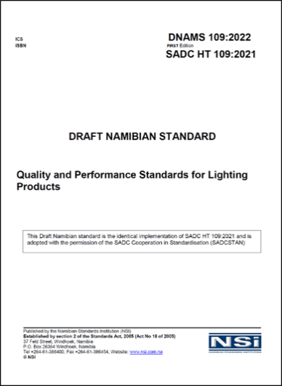
Regional Harmonised Minimum Energy Performance Standards
Regional MEPS for Lighting SADC
SADCSTAN Executive Committee adopted the regionally harmonised Minimum Energy Performance Standards (MEPS) for lighting products on 28 April 2021 and were given reference number SADC HT: 109 2021.
Eswatini, Namibia, DRC, etc adopted the regional MEPS for Lighting

Slide 12
Regional Harmonised Minimum Energy Performance Standards
Regional MEPS for Cooling Appliances SADC
Draft SADC Regional MEPS for cooling appliances available and circulated for review.
National consultations for cooling MEPS were held in 12 out of 16 Member States. and balloting as of 2 September 2022.
As of end of February 2023, Angola, Botswana, Comoros, DRC, Eswatini, Lesotho, Malawi, Mauritius, Mozambique, Namibia, Seychelles, South Africa, Tanzania, Zambia, and Zimbabwe have submitted their ballots.
Regional MEPS for Cooling Appliances EAC
Draft EAC MEPS for cooling appliances available and circulated for 2022 for review and update.
Review of the draft MEPS by EAC Technical Committee to take place in the week of 17th-21st July 2023.
National consultations and regional harmonization meetings to follow.

Slide 13
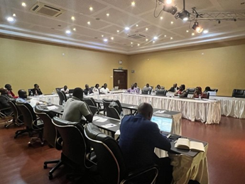
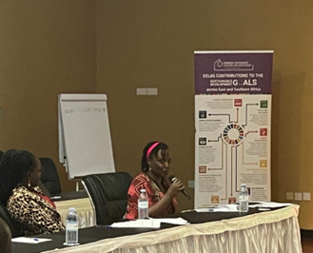
Regional compliance framework for Energy Efficiency Policies
Regional Compliance Framework for EELA in EAC and SADC
The framework supports the implementation of the developed MEPS.
In the SADC region, the national consultations have been conducted. The compliance framework was approved by the SACREEE Steering Committee on 31st March 2023 during the EELA Stakeholder Forum in Nairobi.
In the EAC region, the national consultations expected to take place in July and August 2023
National sensitization & training on the compliance framework in Uganda

Slide 14
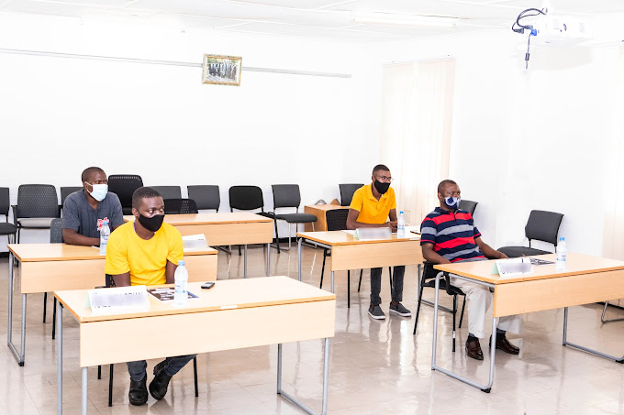
Capacity development
EELA E-learning Platform
The EELA project promotes capacity building at institutional, organisational and individual levels.
EELA Project is conducting a six-months guided training on EELA E-Learning Platform in collaboration with Kafue Gorge Regional Training Centre (KGRTC) in Zambia.
The platform has 5 modules: Module 1 gives a general introduction to EELA and EELA policies, whereas modules 2 to 5 are specialised on specific topics including lighting, clean cooling, productive use, and market development.
The trainings are both virtual and physical.
The project ensures gender inclusivity in the trainings. At least 40% of either gender to be represented.

Slide 15
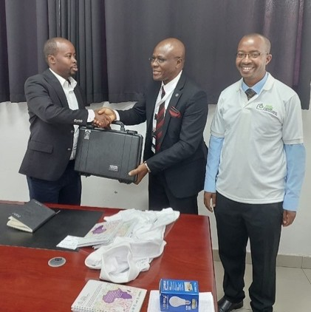
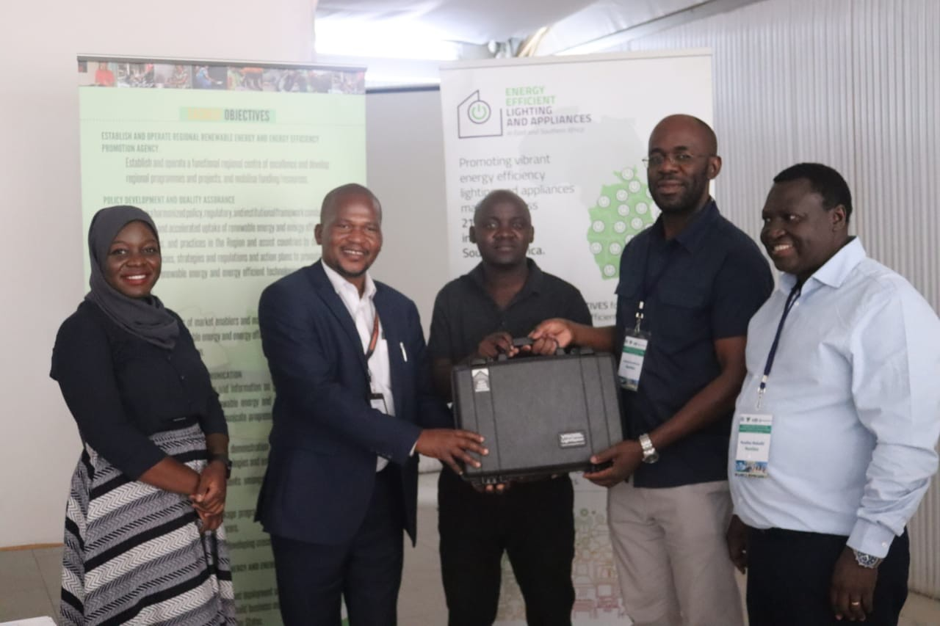
Capacity development
Strengthening Capacities of Market Surveillance on Lighting Products in Member States
The EELA Project procured portable lighting test equipment for 21 EAC and SADC Member States.
The project is also procuring additional lighting test equipment for 3 regional reference labs in the EAC and SADC Member States: Uganda, Zambia and Mozambique.
The projects conducts trainings on the operation and maintenance of lighting test equipment.
LightSpion handover to UNBS
LightSpion handover to UNBS
LightSpion handover to RSB Rwanda
Lighspion hanadover to Malawi

Slide 16
Private Sector Support: EELA Technical Assistance and Co-financing Facility
Windows | Beneficiaries | Target appliances | Target business models | Support provided
Technical Assistance for design of Energy Service Business Models | Energy Users | Energy efficient lighting, cooling, and PuE appliances and equipment | Energy efficient appliance/equipment leasing Energy Performance Contracting Energy-as-a Service | Technical assistance
Co-financing | Energy Service Companies |  | Energy Performance Contracting | Co-financing of up to 75% of the CapEx with Max. EUR 200,000
Technical transition support for manufacturers | Manufacturers |  | Energy-as-a Service | Co-financing of up to 75% of the CapEx with Max. EUR 100,000

Slide 17
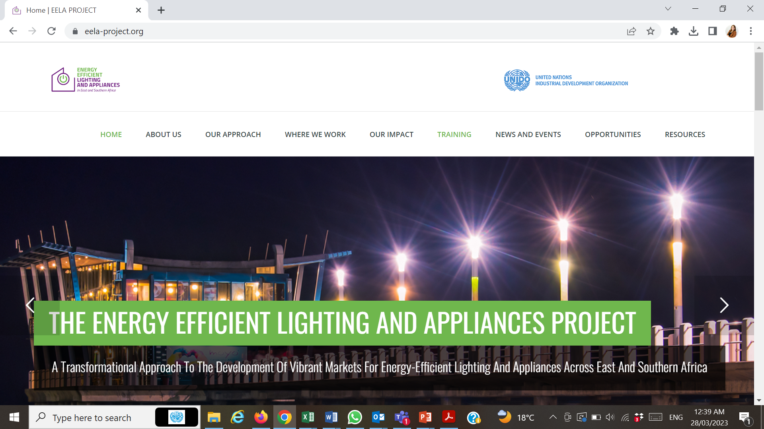
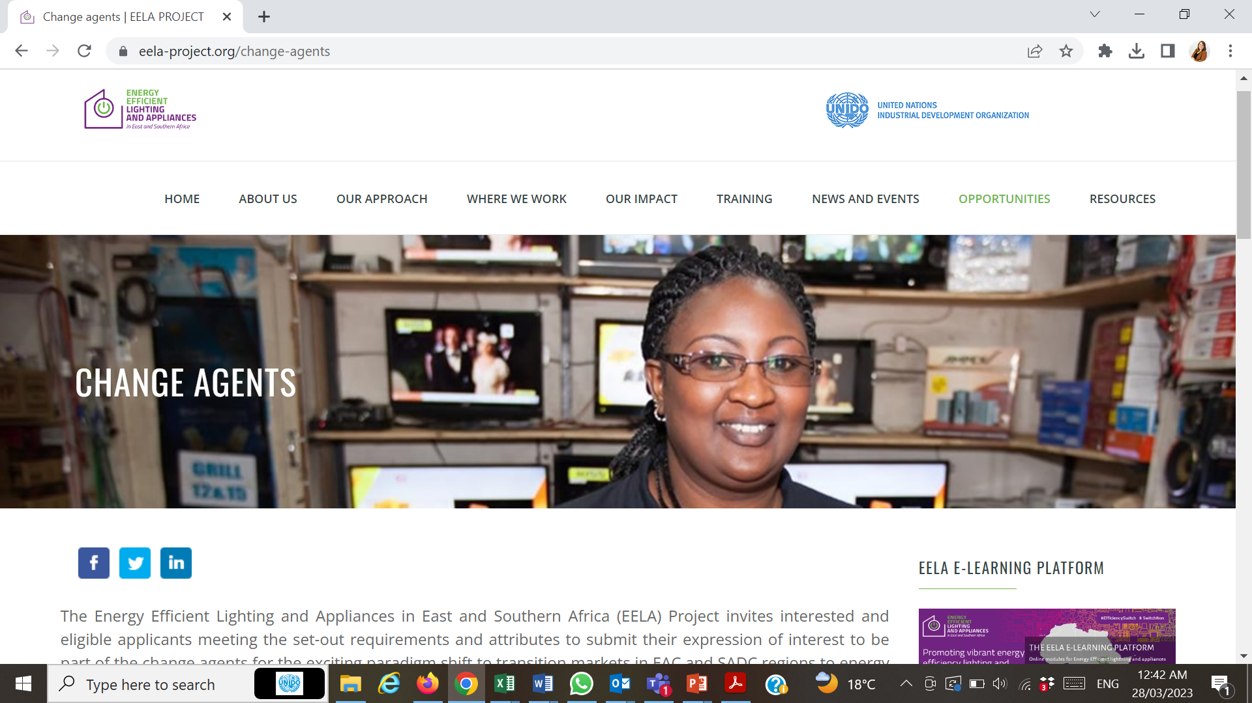
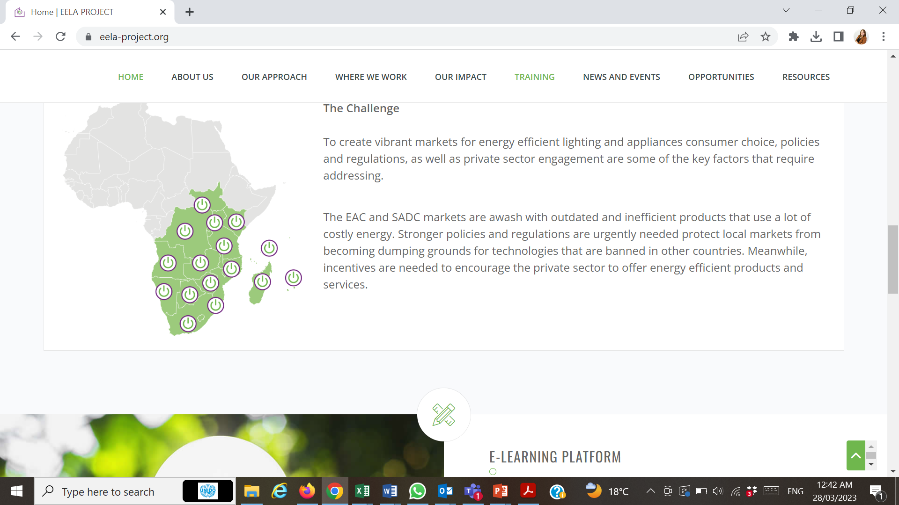
Awareness raising
EELA Webinars
Website and social media
Annual regional stakeholder forums
Participate in regional energy and international climate events: ARE Energy Access Investment Forums, Global Off-grid and Solar Forums, Sustainable Energy for All Forums, etc.

Slide 18
THANK YOU
UNIDO
Ms. Karin Reiss-Haimbala, email: K.REISS@unido.org
Ms. Evita Moawad, email: E.MOAWAD@unido.org
Mr. Ndivhuho Tshikovhi: N.TSHIKOVHI@unido.org
EACREEE
Mr. Denis Ariho, email: d.ariho@eacreee.org
Ms. Mary Bwabye, email: m.bwabye@unido.org
SACREEE
Mr. Readlay Makaliki, email: readlay.Makaliki@sacreee.org
Ms. Asteria Markus, email: Asteria.markus@sacreee.org
For further information, visit:
www.eacreee.org | www.sacreee.org | www.unido.org

