Slide 1
WEBINAR: Energy Efficient Lighting and Appliances (EELA) Project in East and Southern Africa
JUly 5, 2023
Case studies on translating
EELA targets in the NDCs
into EELA projects
Country ENGAGEMENT FINANCE SPECIALIST, NDC PARTNERSHIP
David Levy

Slide 2
“Energy efficiency is no longer an option. It is a priority because we are in a climate emergency."
"For the public, this means lower bills and more to spend elsewhere; for energy companies, it means lower spending on production inputs, better-managed demand and better consumer purchasing power. Energy efficiency is a central driver of the energy transition."
Jalel Chabchoub, chief investment officer in the African Development Bank's Renewable Energy and Energy Efficiency Department.
.

Slide 3
IMPROVING ENERGY EFFICIENCY
Demand Side
Improvements in energy efficiency are reductions in the energy required to maintain or improve energy services to households, businesses, and communities. It has two sides. Supply-side energy efficiency approaches target energy generation via grid infrastructure, utilities, and power producers. Demand-side energy efficiency (DSEE) focuses on the energy use of industries, commercial entities, and households. Here we will talk about the demand side.
Air conditioners, lighting, industrial motors and refrigerators are responsible for 40% of global electricity consumption and produce 5 Gt of global CO2 emissions each year—roughly equivalent to the total emissions produced by the United States in 2020.¹
Investments at scale are needed to realize the untapped potential of energy efficiency. The rate of improvement in global energy efficiency (the rate at which global gross domestic product per unit of energy used increases) needs to nearly double to meet the SDG 7 (energy access) target. Moreover, it needs to increase by more than 2.7 times to achieve the ambitions of the Paris Agreement. In addition, meeting SDG 7, SDG 13 (climate action), and the ambitions of the Paris Agreement—and reaping the other economic and social benefits associated with energy efficiency—requires closing a $500 billion a year².
1) EIA, “In 2020, the United States Produced the Least CO2 Emissions from Energy in Nearly 40 Years,” US Energy Information Agency, 2021, https:// www.eia.gov/todayinenergy/detail.php?id=48856.
2) https://ieg.worldbankgroup.org/sites/default/files/Data/Evaluation/files/Demand-side-energy-efficiency.pdf Independent Evaluation Group.

Slide 4
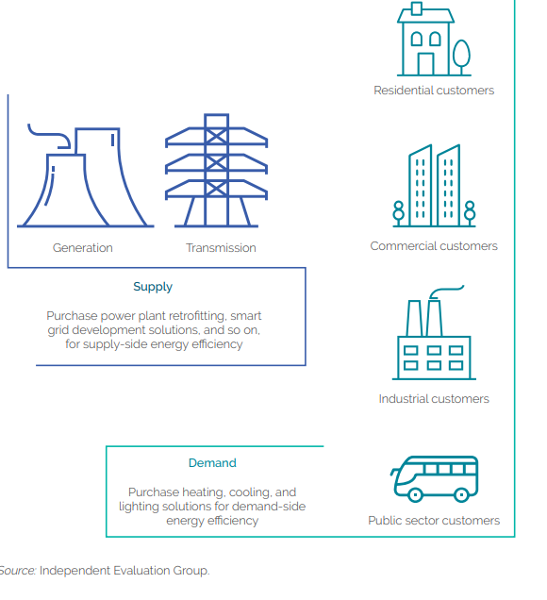
ENERGY EFFICIENCY SUPPLY AND DEMAND

Slide 5
EELA Project Preparation
Enabling environment for the project
A conducive enabling environment for investment is often a key differentiator between countries that successfully scale up investment and those that face challenges in doing so.
A robust policy framework: that signals clarity, consistency and stability of government actions, while providing for agility to adapt and manage changes in the wider infrastructure ecosystem
Well-governed public institutions: with a clear role, mandate, and commensurate capacity to operationalize policy into effective and smooth project preparation and implementation.
Financing project preparation
Considering that the cost of developing projects can be substantial, national and sub-national Project Development Funds (PDFs) and Project Preparation Facilities (PPFs) could be considered, in addition to the government budget.

Slide 6
EELA PROJECT PEPARATION (CON’T)
Planning and project prioritization
Well-planned investment strategy improves contributes to long-term sustainable economic growth. Effective project preparation starts with putting in place upstream mechanisms to formulate long-term infrastructure plans and translating those plans into prioritized project pipelines.
Project feasibility, reviews and approvals
Translating a concept into a bankable project requires rigorous evaluation and appraisal of the project’s feasibility, and often requires a multi-stage evaluation, starting with concept definition, and moving through to pre-feasibility assessment and detailed feasibility evaluation Project communication.
.
Project communication
Communication during project preparation is key and should involve all key stakeholder groups in the project. Key stakeholders should be mapped, and the intensity of communication efforts should be assessed. An appropriate communication plan should be developed.

Slide 7
INVESTMENT AND FINANCING
Investment
Investments in efficient equipment generally produce cost savings over the course of several years. Customers seldom see the financial benefits of EE equipment in the short term. This can discourage investments, which often come with high capital costs. These can be prohibitive for companies with limited access to loans from the formal banking sector (high interest rates, short tenors, large financial securities). Therefore, the public sector can play a role in promoting EE investment.
Financing
Strategic use of public funds can attract additional sources of capital by leveraging private sector participation in energy efficiency project. Public institutions must work to remove barriers hindering investment from private actors, to meet the immense potential of RES in Africa. Innovative financing and de-risking mechanisms will be essential in this effort.
New instruments are being designed to leverage additional private capital and develop a financing ecosystem that is sustainable over the long term. A prominent approach involves blending concessional loans with funds from DFIs and entities investing on commercial terms, to improve the financial viability of projects and unlock private financing.

Slide 8
EELA PROJECT Potential Structure
Energy Efficiency Service Company (ESCO)
Company primarily dedicated to designing, installing and maintaining energy efficiency solutions for commercial customers to reduce energy consumption and GHG emissions at the customer’s properties.
The ESCO’s typical contract structure is performance-based, where its remuneration is linked to the energy savings achieved by its customer (Energy or Efficiency Service Agreement).
The ESCO funds upfront the cost of designing, engineering, procuring and building or installing the necessary Energy Efficiency Facility (EFF), and to operate and/or maintain the EEF for a determined term. Its remuneration is calculated primarily with reference to the actual energy cost savings achieved.
Typically, ESCOs are financial parties that subcontract the actual performance of the work and services to a third-party contractor.
ESCO energy efficiency transaction could consider project finance on a limited recourse basis.

Slide 9
Voluntary Carbon Markets (VCMs)
The VCM is a decentralized market where private actors voluntarily buy and sell carbon credits that represent certified removals or reductions of greenhouse gases (GHGs) in the atmosphere.
Voluntary carbon markets (VCMs) are starting to play an important role complementing direct decarbonization efforts. Globally, VCMs grew at a compound annual rate of over 30 percent from 2016 to 2021³ (based on carbon credit retirements).
This creates an opportunity for Africa to develop carbon projects that could channel international investment to address environmental challenges, while driving development priorities such as expanding energy access, improving health through clean cooking, and creating jobs.
Out of total credits issued worldwide between 2016 and 2021, only about 11 percent stem from African countries. It is estimated that Africa currently generates only ~2 percent of its maximum annual potential of carbon credits⁴, indicating room for growth in Africa.
Household Devices: ~200 million people in Africa using charcoal for cooking fuel could see significant health benefits from switching to highly efficient coal stoves, natural gasifier stoves, liquid petroleum gas stoves and renewables stoves such as solar⁵.
3,4) McKinsey Vivid Economics Carbon Credit Database, drawing on Verra, Gold Standard, ACR, CAR, Plan Vivo (2022)
5) https://www.seforall.org/system/files/2022-11/ACMI_Roadmap_Report_Nov_16.pdf
1) McKinsey Vivid Economics Carbon Credit Database, drawing on Verra, Gold Standard, ACR, CAR, Plan Vivo (2022)

Slide 10
EELA Project – LOW carbon Transformation OF THE Rwandan TEA Processing Sector
Country: Rwanda
Objective: To shift the tea processing sector towards a low carbon and green development path.
Project Cost: Estimated at US$61.1 Million
EELA: The energy efficiency investments include upgrading the efficiency of the boilers, fuel wood properly dried and stored, reduce energy use, and to use renewable energy sources or energy efficiency to reduce/decarbonise ancillary electricity for multiple tea factories.
Rationale: Tea is Rwanda’s main agricultural cash crop. The NAMA analysis identified tea factories as the largest current industrial source of GHG. It recommended an energy efficiency program.
NDC Alignment: The Project is aligned with the NDC Partnership Plan, which highlights priority actions for NDC implementation in line with the national development objectives. The PP also mobilizes and tracks partner support and implementation for these needs.
UNIDO’s Support: In response to the Project Information Notes (PINs), UNIDO is supporting the project development and the engagement with potential sources of financing.
.

Slide 11
ELLA PROJECTS – African Development Bank (AfDB)
The African Development Bank (AfDB) adapts its support to countries according to their needs. It assists with identifying energy efficiency programmes and fostering a conducive environment to the development of the energy-efficiency market.
Morocco was the first country to receive TA to set up a Super ESCO, in Feb. 2021. The Energy Engineering Company received a grant to become Africa’s first Super ESCO. It will develop energy efficiency projects to support improvements in energy performance of public buildings and street lighting.
In Kenya, a different model has been adopted. In Sep. 2021, Sustainable Energy Fund for Africa (SEFA) provided a grant to the Kenya Power and Lighting Company to create its Super ESCO. It will support the development of energy-efficient projects for the benefit of the public sector, as well as the possible expansion of the services EnPC offers to the private sector. Projects focus on the rehabilitation of building, renovation of electrical AC and heating systems, new efficient technologies, and system optimization.
In Egypt, for example, it is supporting the establishment of energy-efficiency programmes such as replacing one million refrigerators nationwide. In Namibia, it is supporting the development of solar water heating programmes. In Mozambique, it is helping with the deployment of efficient street lighting and supporting the adoption of an on-bill financing mechanism to allow recovery of the cost of acquired energy-efficient equipment through monthly settlement of energy bills.

Slide 12
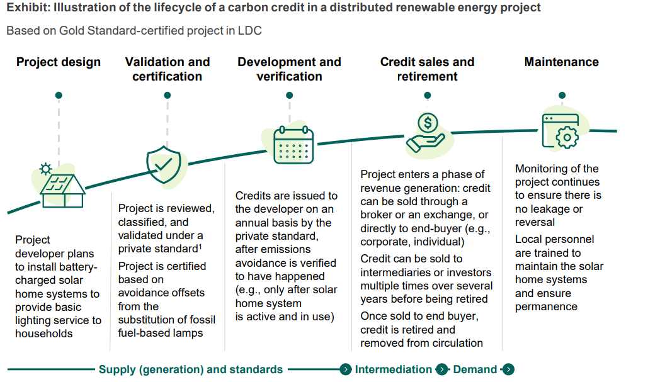
Project – Voluntary Credit Markets (VCMs)
African Carbon Markets Initiative (ACMI): Road Map Report

Slide 13
THANK YOU!
David.Levy@ndcpartnership.org

