Slide 1
Overview of the Relevance of EELA in the NDCs
Thibaud Voïta
July 5th, 2023

Slide 2
Outline
Why EELA?
What are the barriers to achieving better energy performance of EELA?
Can NDCs help address EE barriers?
Policy recommendations

Slide 3
Notes:
So, what happened in 2015 firstly the publication of the SDGs by the UNGA. It includes a SDG specifically focused on energy, and within this SDG, a goal on energy efficiency. For the first time, energy is officially recognized as an important means of development, and EE is part of it.
The goal is to double the rate of improvement in Energy Efficiency. Nobody really knows what this means and what it entails, but it‘s great news.

Slide 4
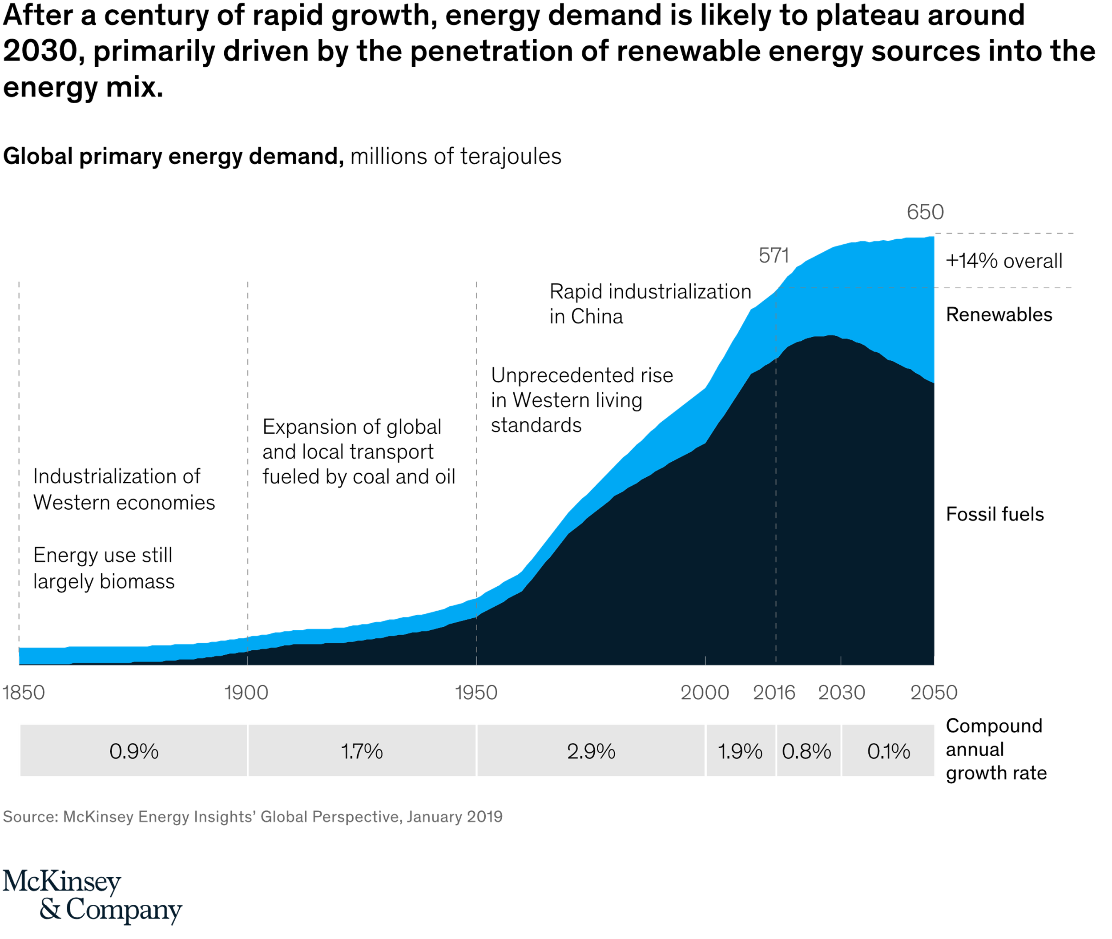
Decoupling energy demand and growth?
Decoupling can be measured through Energy Intensity (Unit of consumed energy/Unit of GDP)
Notes:
The second factor checking energy demand is the increased efficiency with which energy is put to use. While a growing middle class in many emerging economies will trigger spectacular increases in the demand for products such as refrigerators, laundry machines, and air conditioners, advances in LED lighting, smart appliances, and other applications will substantially lessen the energy intensity of households worldwide. In more developed countries—and to an extent, globally—changes in users’ mind-sets will also boost efficiency. Not only are people beginning to be more conscious about their behavior (such as turning off lights and air conditioners when they’re not in use), they’re benefitting from innovations such as automatic sensors and controlled devices, which eliminate the bother of worrying about such things.
Companies across sectors will reap the benefits as well. Precisely, because energy costs can comprise a significant share of total expenses in a variety of business models, energy savings often have an outsized effect on the bottom line. This incents implementation of efficiency measures and makes it likely that large-scale improvements will come faster. And while it is conceivable that if electricity costs decline dramatically, incentives to change behavior, invest in efficiencies, and alter consumption patterns could be diminished as a result, so far the trends toward efficiency continue unabated as the demand for electric power grows. Government-mandated standards will also help accelerate adoption and enforce switching. Efficiency investments that are more quickly in the money, such as lighting and improved heating, ventilation, and air-conditioning (HVAC) systems, will likely be implemented first. Yet even projects with longer payback times and more expensive efforts, such as significant decarbonization initiatives, will eventually be commercialized, tamp down energy needs over the longer term, and prove a net positive for value creation.
For plants and factories, energy efficiencies will manifestly help move the needle. Within the global buildings segment, energy intensity will decline as new, energy-efficient technologies are adopted. As a result, the energy needs per capita at a global level will be 10 percent less in 2050 than they were in 2016, despite the rapid rise in demand from the many households entering the middle class in emerging economies. And the transportation sector will realize some of the most dramatic efficiencies of all. The shift to electric vehicles (EVs), combined with improvements to internal-combustion-engine (ICE) vehicles, means that overall energy needs for road transport will increase only slightly—even while the total number of cars and trucks on the world’s roads will likely more than double.²

Slide 5
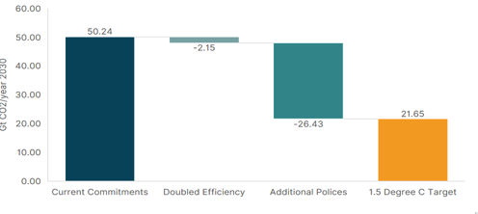
As AL usage is increasing, so is the need to decarbonize the sector
Decarbonization will only be possible through an acceleration of electrification
Appliances energy demand is expected to grow by 10% between 2020 and 2030 (BAU)
EEAL benefits also include energy access
Potential for doubled efficiency to help global emissions gap (CLASP)
Notes:
5
F I G U R E 1: P OT E N T I A L F O R D O U B L E D A P P L I A N C E E F F I C I E N C Y TO
H E L P C LO S E G LO B A L E M I S S I O N S GA P
Note: This graph shows the emissions gap under current NDCs. The bar on the far
right (‘1.5 Degree C target’) shows estimated global annual emissions needed to stay
on track with the Paris Agreement’s 1.5° C target in 2030, while the bar on the far
left (‘Current Commitments’) shows estimated annual emissions with current NDCs.
The ‘Doubled Efficiency’ bar shows the emissions that could be mitigated by doubling
the efficiency of four products (air conditioners, lighting, motors, and refrigerators).
Finally, the ‘Additional Policies’ bar shows the remaining emissions that must be
mitigated through new commitments. Please note the ‘Doubled Efficiency’ bar does
not account for appliance policies already included in NDCs.

Slide 6
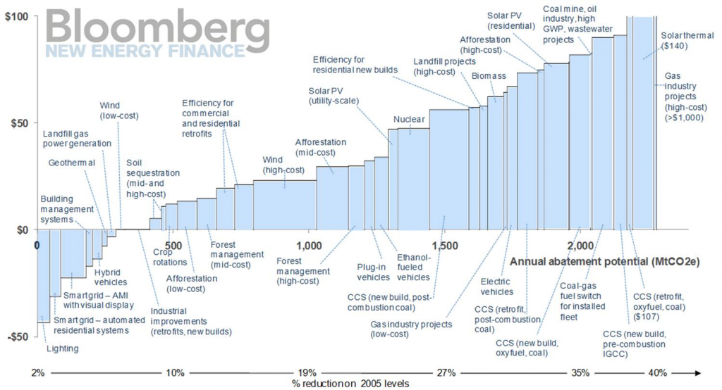
How much does it cost (climate)? The Marginal Abatement Cost Curves
Notes:
https://www.sustainsuccess.co.uk/the-big-macc
Most members of IEMA will undoubtedly have heard of Marginal Abatement Cost Curves, which are regularly used in climate change circles to help visualise complex data about carbon costs and emissions volumes. Below is an example of such a “curve” which illustrates the potential for different technologies to reduce greenhouse gas emissions in the USA.
If we look at the chart we can see that the technologies are ranked in ascending order of cost per tonne CO₂equivalent (tCO₂e)– that is to say that those projects that have the lowest cost (per tCO₂e reduced) are on the left and those with the highest cost are on the right. Technologies below the line actually make a saving (a negative cost) over their lifetime – perhaps because they reduce energy consumption as well as carbon.
Bloomberg’s curve illustrates that “Lighting” is the most cost-effective technology, at a net saving of just under $50 per tonne CO₂e abated on the left hand side, while way over to the right we have “Solar Thermal” and “Gas industry projects”, which have a net cost of over $100 per tonne over their lifetimes.

Slide 7
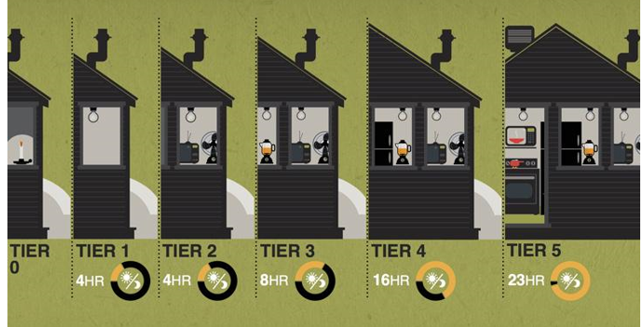
EEAL and Energy Access
From ESMAP

Slide 8
Outline
Why EELA?
What are the barriers to achieving better energy performance of EELA?
Can NDCs help address EE barriers?
Policy recommendations

Slide 9
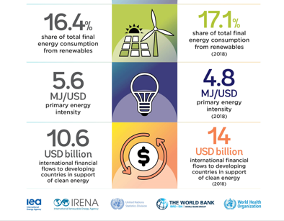
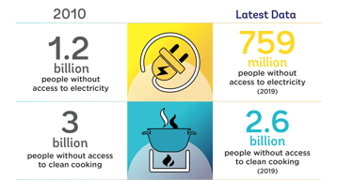
2021 Tracking SDG7 Progress Report
Notes:
We are not on track to achieve SDG7 goals. We were not a few years ago (in 2021), and things look even worse today.

Slide 10
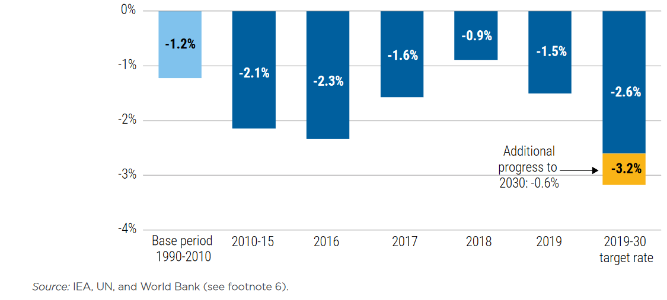
Is the decoupling really happening?
Growth rate of primary energy intensity by period and target rate, 1990–2030
Notes:
Achieving SDG target 7.3—doubling the global rate of improvement in energy intensity relative to the average rate over the period from 1990 to 2010. in essence, the amount of energy used per unit of wealth created. By using this measure of energy intensity to understand efficiency, we can observe how energy use rises or falls while also looking for the (social and economic) development factors that may affect those rates, along with other factors such as weather and behavior change. In general, energy intensity declines as energy efficiency improves. Progress toward SDG target 7.3 is measured by tracking the year-on-year percentage change in energy intensity. Initially, an annual improvement rate of 2.6 percent between 2010 and 2030 was recommended by the United Nations to achieve the target, but since global progress has been slower than that in all years except 2015, the rate now required is at least 3.2 percent (figure 4.1). Nevertheless, global energy intensity has shown gradual improvement since 19906 (figure 4.2). Recent numbers show that global energy intensity improved by 1.5 percent in 2019 to 4.69 MJ/U.S. dollar (2017 PPP [purchasing power parity]). This was the second lowest rate of improvement since the global financial crisis, but still better than the previous year’s rate.

Slide 11
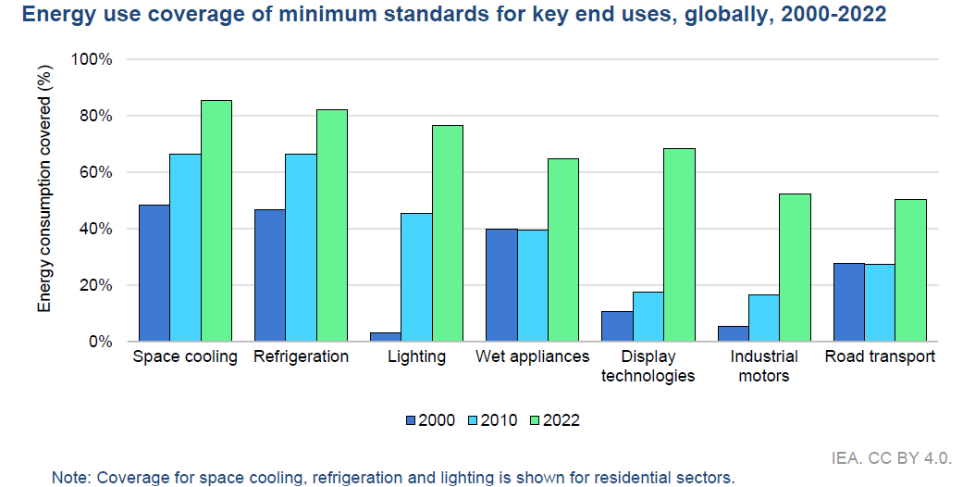
Low Hanging Fruit such as Standards & Labels are not easy to Implement in Some Countries

Slide 12
It requires Compelling Narratives
Energy Efficiency Watch

Slide 13
Outline
Is EELA delivering its promises?
What are the barriers to achieving better energy performance of EELA?
Can NDCs help address EE barriers?
Policy recommendations

Slide 14
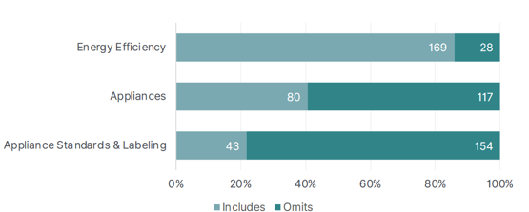
Are NDCs considering EELA?
Share of NDCs Referring to EE and Appliances (CLASP, 2022)

Slide 15
What can NDCs do?
What NDCs can do
Challenges that may remain
Improve policy planning
Set clear targets and goals, linking them to LTS for 0-emission targets
Identify policy tools to accelerate the role of EE
Attract technical and financial support
Promote international cooperation
Nation-wide implementation
Address counterfeiting issues
Prevent imports of low-energy performance products
Outreach to customers
Limit rebound effect

Slide 16
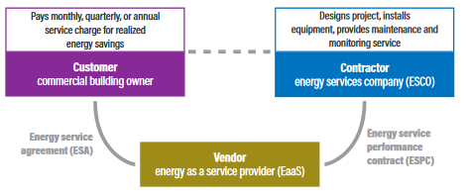
Promoting EEaS through NDCs?
ACEEE

Slide 17
Outline
Is EELA delivering its promises?
What are the barriers to achieving better energy performance of EELA?
Can NDCs help address EE barriers?
Policy recommendations

Slide 18
Some policy proposals
Include EELA in your future or updated NDCs
Establish or expand EELA policies
Promote EE among populations through information campaigns about its benefits
Work with financial institutions to promote innovative solutions promoting energy efficient lighting and appliances
Launch campaigns against fake products

